Slide 1
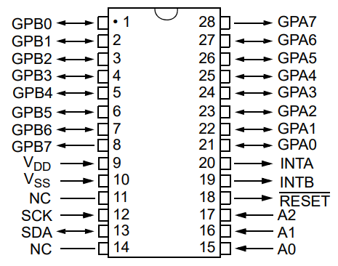
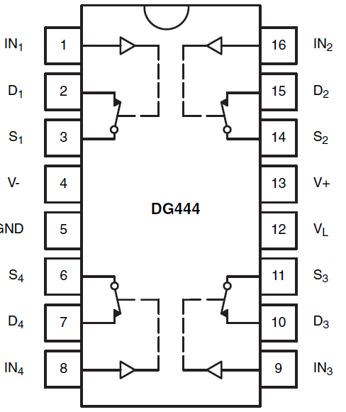
//
+5
//
VL=2.5V
GPB0 MUX1
GPB2 MUX1
GPA6 MUX1
WE1
WE2
WE1
WE2
WE1
WE2
1WE1
1WE2
3WE1
3WE2
15WE1
15WE2
MUX 1
000
-5
+5
-5
+5
…..
-5
+5
+5
DG445
+2.5
DG445
+2.5
DG445
+2.5
2WE1
2WE2
4WE1
4WE2
16WE1
16WE2
GPB1
GPB3
GPA7
//
GPB0 MUX2
GPB2 MUX2
GPA6 MUX2
MUX 2
001
WE1
WE2
WE1
WE2
WE1
WE2
+5
17WE1
17WE2
19WE1
19WE2
31WE1
31WE2
-5
DG445
+5
-5
DG445
+5
…..
-5
DG445
+5
+2.5
+2.5
+2.5
1uF
1uF
18WE1
18WE2
20WE1
20WE2
32WE1
32WE2
+5
WE2
SCK
SDA
RESET
GPB1
GPB3
GPA7
WE1
Serial in
+5
-5
GND

